Slide 1


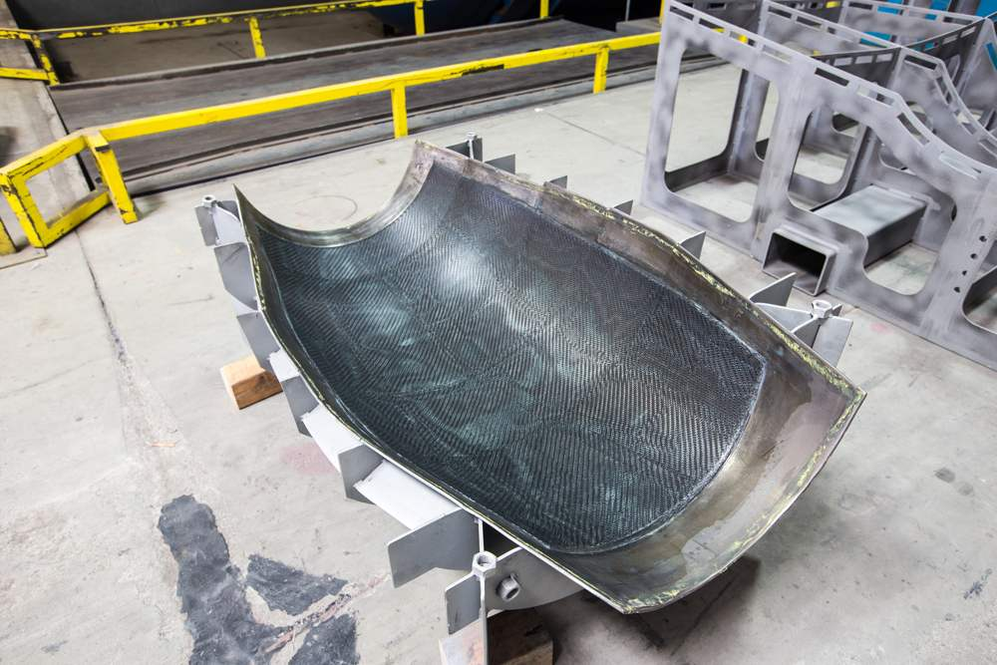
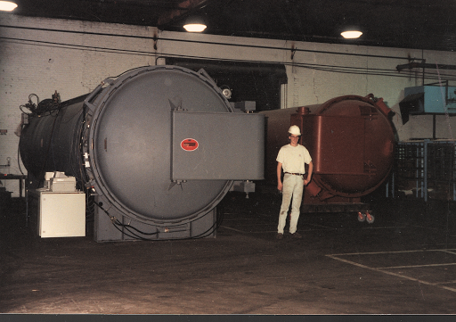
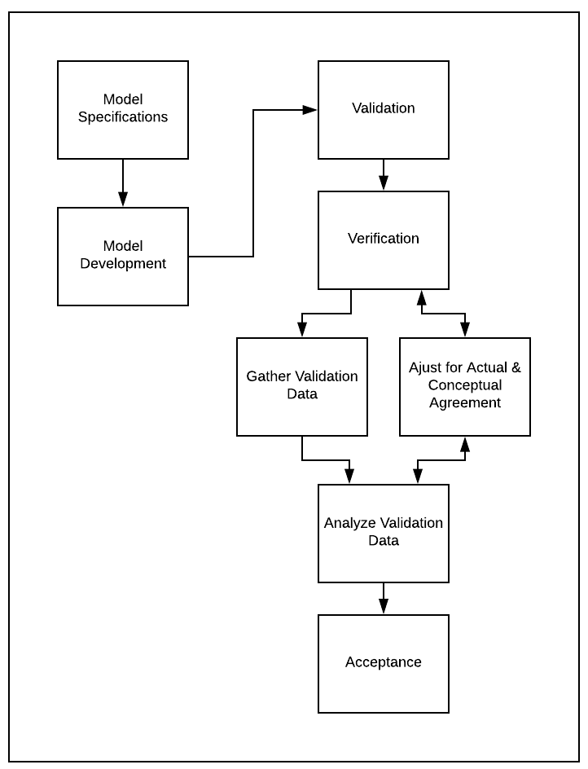
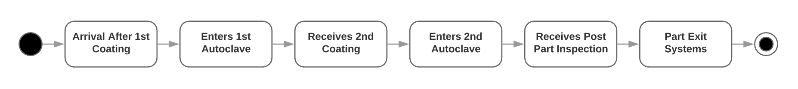
United Technologies Corporation Aerospace Systems
Julian Chulovskiy, Andrew Garcia, Luis Gama, Christopher Miller University of Arizona SIE 431 Project
Introduction
Assumptions
An autoclave is most commonly used in industry for curing composite materials in both a mechanical and chemical process. In the mechanical process pressure is applied to remove trapped air to help mold individual fibers and plies together. In the chemical process a crosslink reaction is initiated to complete a rigid mold, this process is initiated through the heat or ultraviolet exposure. Each part process is slightly different due to dimension constraints so the cure cycles for a specific application varies since it is determined by using calculations to derive empirical data to develop cure cycles for parts or materials to ensure desired properties.
The average autoclave cure cycle is broken down into a two-step process. The first process consists of creating a vacuum and then pressurized environment while temperature gets heated up to a moderate level and held there for about four hours , the heat reduces the viscosity of resin materials to flow and reach trapped air pockets. In the second stage of the process the temperature is ramped up to a final curing temperature and held there for 24 hours to complete the cure ration.
There are only two kinds of parts, small and large parts, that flow through the system.
The transfer and service times are constant for the parts not matter the size. The only different from this is that the large parts are 75% 8 hours bake in the autoclave and 25% 12 hours bake.
This was done to better mimic the recipes in the autoclave for different large parts.
The arrival data is only from 2.5 months worth of data.
Therefore there may be outliers that could not be seen in this period, but a larger period would be needed.
Suggestion
The base scenario contained 7 large autoclaves and 7 teams of 3 people applying the second coat or doing the final inspection.
The recommended scenario contains two teams of 3 people applying the second coat or doing the final inspection and only 4 large autoclaves.
Results
Actual Data | In
large | 2282
small | 203
Total | 2485
Times through system
[hours] | Base Scenario |  | Recommended Scenario
Part | Wait time | Total Time | Wait Time | Total Time
Small | 12.098 | 27.386 | 10.779 | 26.087
Large | 2.790 | 30.552 | 4.088 | 31.831
Arena model | In
large | 2319.76
small | 165.05
Total | 2484.81
Utilization
Scenario/Section | Large Coating | Small Coating | Large Resource (Autoclave) | Small Resource (Autoclave)
Base | 0.185 | 0.136 | 0.400 | 0.177
Recommended | 0.646 | 0.156 | 0.698 | 0.202
Scenario | Number of Autoclaves (large) | Number of teams (of three) working on coating and inspection
Base | 7 | 7
Recommended | 4 | 3
Problem Description
Example of parts created by UTC Aerospace that are sent through the autoclave(s)
The goal for UTC Aerospace Systems is to increase final output productivity by increasing the utilization of the resources in the system. The simulation will model each autoclave process including: sorting parts by size, putting parts into an autoclave, parts receiving two proprietary coatings, parts returning to an autoclave and then being sent to a final inspection before the part exists the system.
The goal of this project will be to find solutions to mitigate the issue of having low resource utilization and non-existent queues.
The reason why this project was chosen was because we were able to access the data for this process and help apply our education in simulation and modeling to solve a real problem.
Discussion
After creating and running the model, we found that the interarrival times we calculated led the model to generate closely the same number of parts entering the system just like the recorded data shows. The total number of parts that entered the actual model was 2,485. Fortunately, the average total number of parts that entered the model was 2,484.81. This shows an incredible amount of precision for our interarrival times.
After running multiple scenarios in the process analyzer, we compared the base results to different resources in each scenario. The first scenario consisted of the base scenario with 100 replications. The controls for the Process Analyzer included all four of the resources in our model (large autoclaves, small autoclaves, large part coaters/inspectors and small part coaters/inspectors).
The base scenario contained 7 large autoclaves and 7 teams of 3 people applying the second coat or doing the final inspection. The recommended scenario contains two teams of 3 people applying the second coat or doing the final inspection and only 4 large autoclaves,
Although the recommended results for the total time in the system are slightly higher than the baseline, the utilization of the teams are higher, allowing for more parts to be worked on instead of workers waiting for the parts to exit the autoclave. The utilization was increased dramatically for the large parts and slightly increased for the small parts.
Conclusion
Modeling and Simulations are an integral part of the development process early on in the engineering life cycle, by optimizing early on you can explore the design trade space and make appropriate design decisions in conjunction with testing and analysis to make the system perform as intended. The goal of this project was to find solutions to mitigate the issue of backed up parts near the autoclaves.
Our solutions was to increase utilization of the autoclaves. The recommended scenario contains two teams of 3 people applying the second coat or doing the final inspection for only 4 large autoclaves, while the current staffing is 7 large autoclaves and 7 teams of 3 people applying the second coat or doing the final inspection
The utilization was increased dramatically for the large parts and slightly increased for the small parts, as can be seen in table 5.2.1. The optimal scenario increased the total time by about one hour for the large, but cut the time for the small by about the same as can be seen in table 5.2.2. This may be unwanted as there is a magnitude difference in the number of large parts to small parts, but the utilization for the large was the true goal, not the total time.
Arena Model
The parts that are put through the model have two categories, small and large. This is in part to protect the UTC aerospace corporation, its contracts, and assets.
The arena model is broken up into the following sections modeling the flow of parts through the UTC Aerospace facility:
Arrival of small and large parts after first coat
Batching the parts and baking them in the respective autoclave
Transport of parts for second coat
Second coat application
Second batch and bake in respective autoclave
Final inspection
Exit from system
The arrival data was modeled after the actual data from the true arrival of parts. Using Arena and statistics, an arrival equation was found for both small and large parts.

